Slide 1
Food chain analytics
File created on: 15-02-2023 16:33:33
By Harshit Kumar Singh
15 Jan Batch

Slide 2
Dashboards

Slide 3
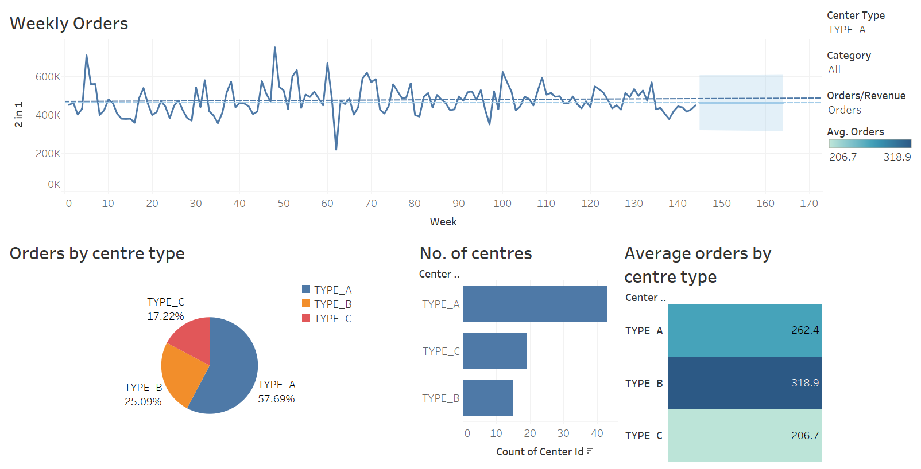

Slide 4
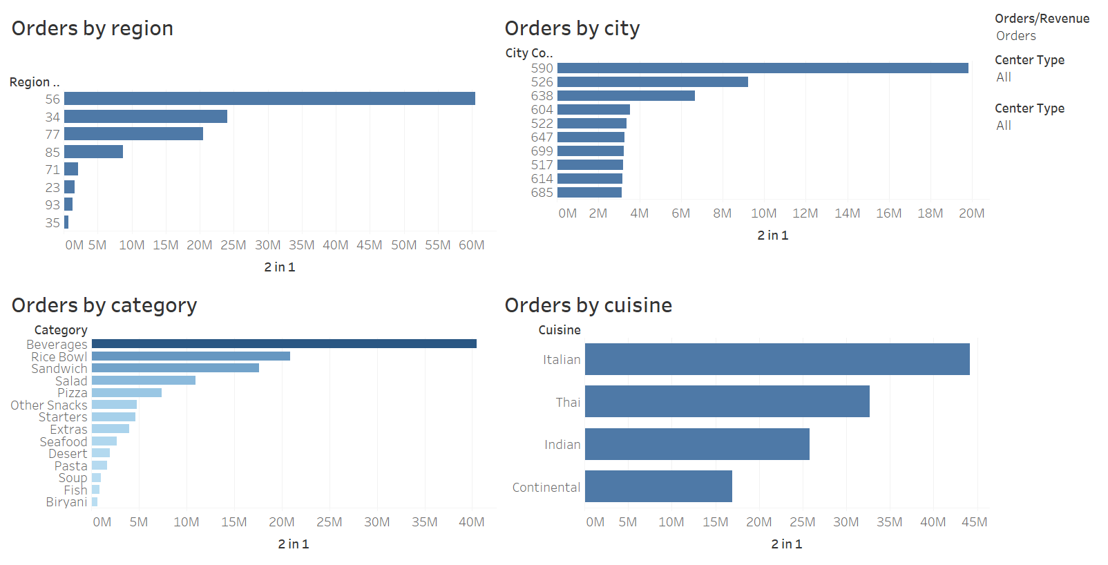

Slide 5
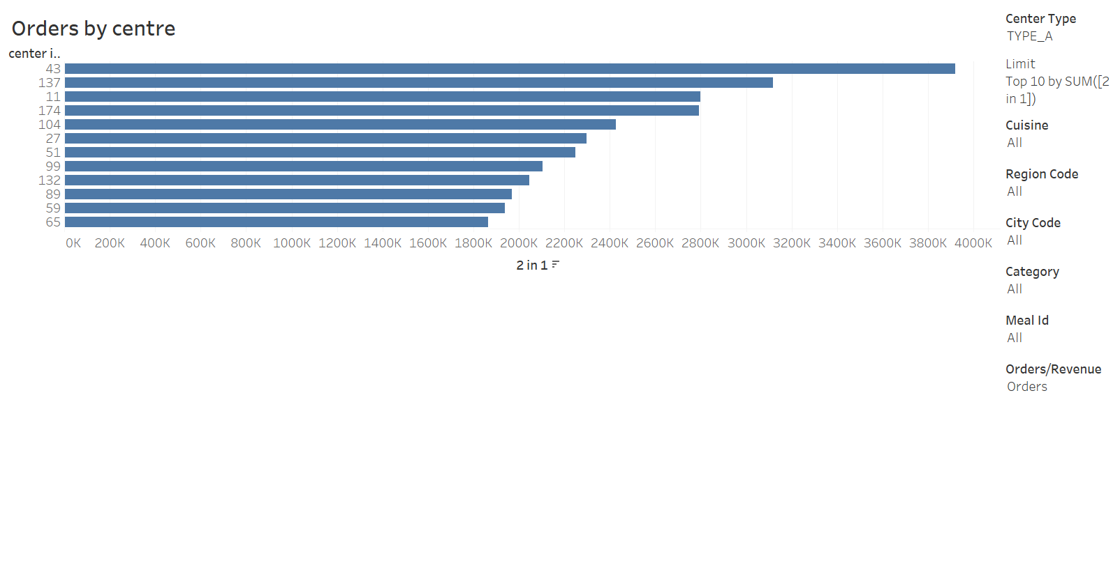

Slide 6
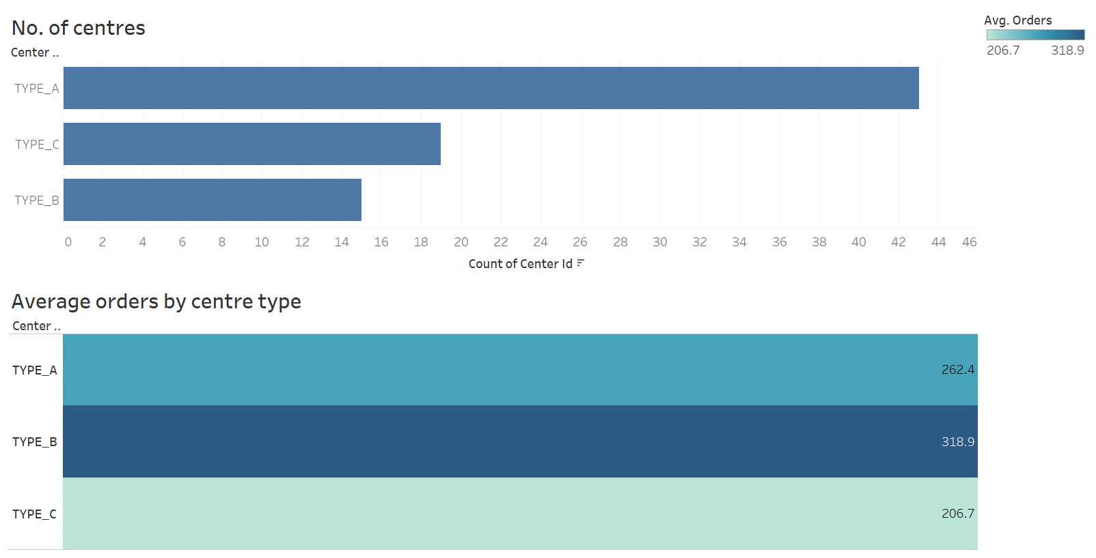

Slide 7
Story

Slide 8
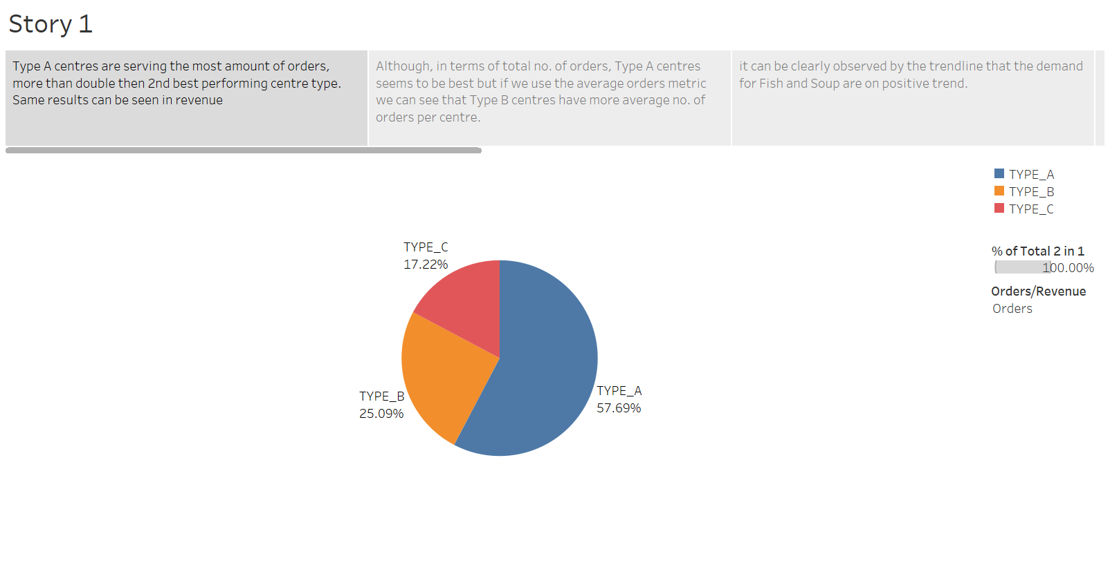

Slide 9
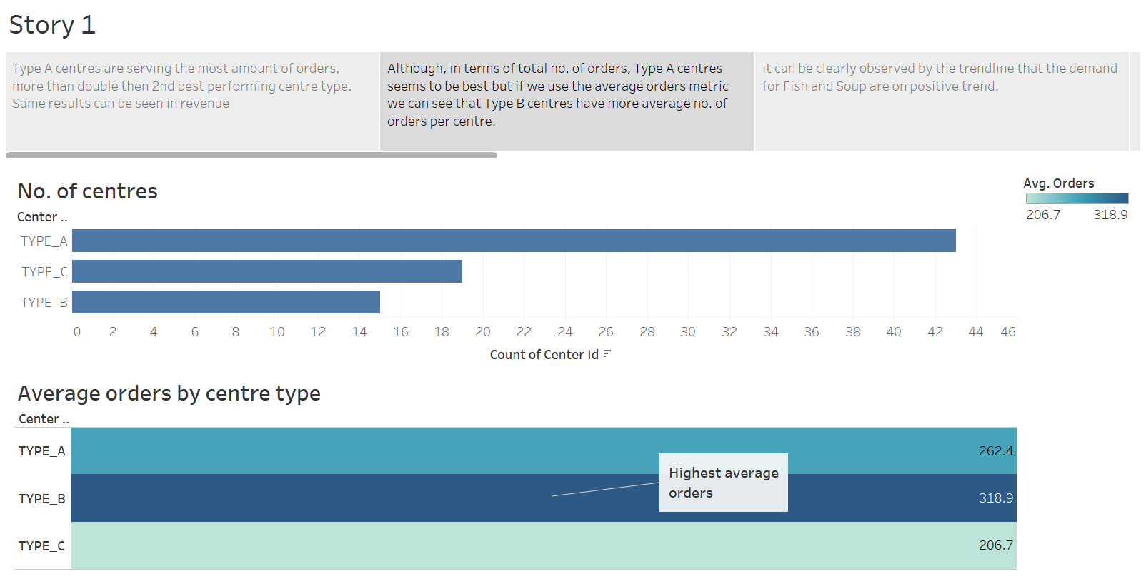

Slide 10
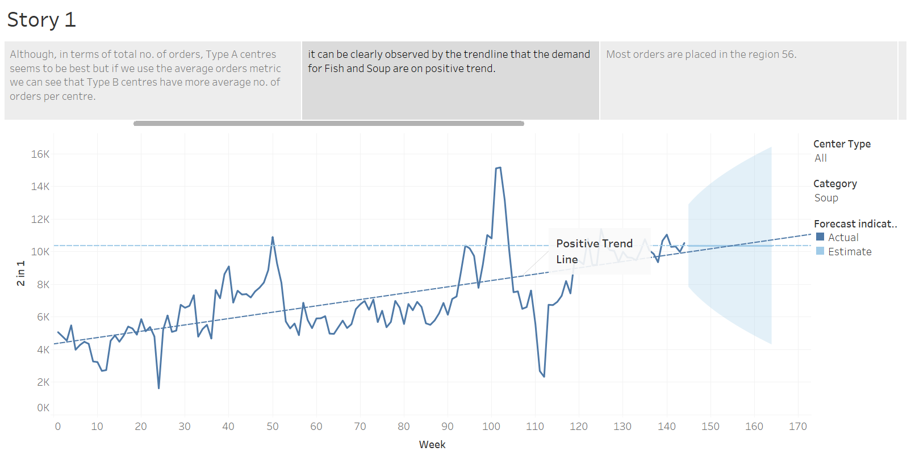

Slide 11
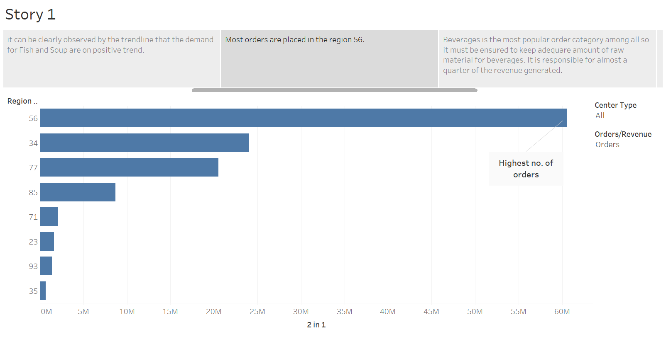

Slide 12
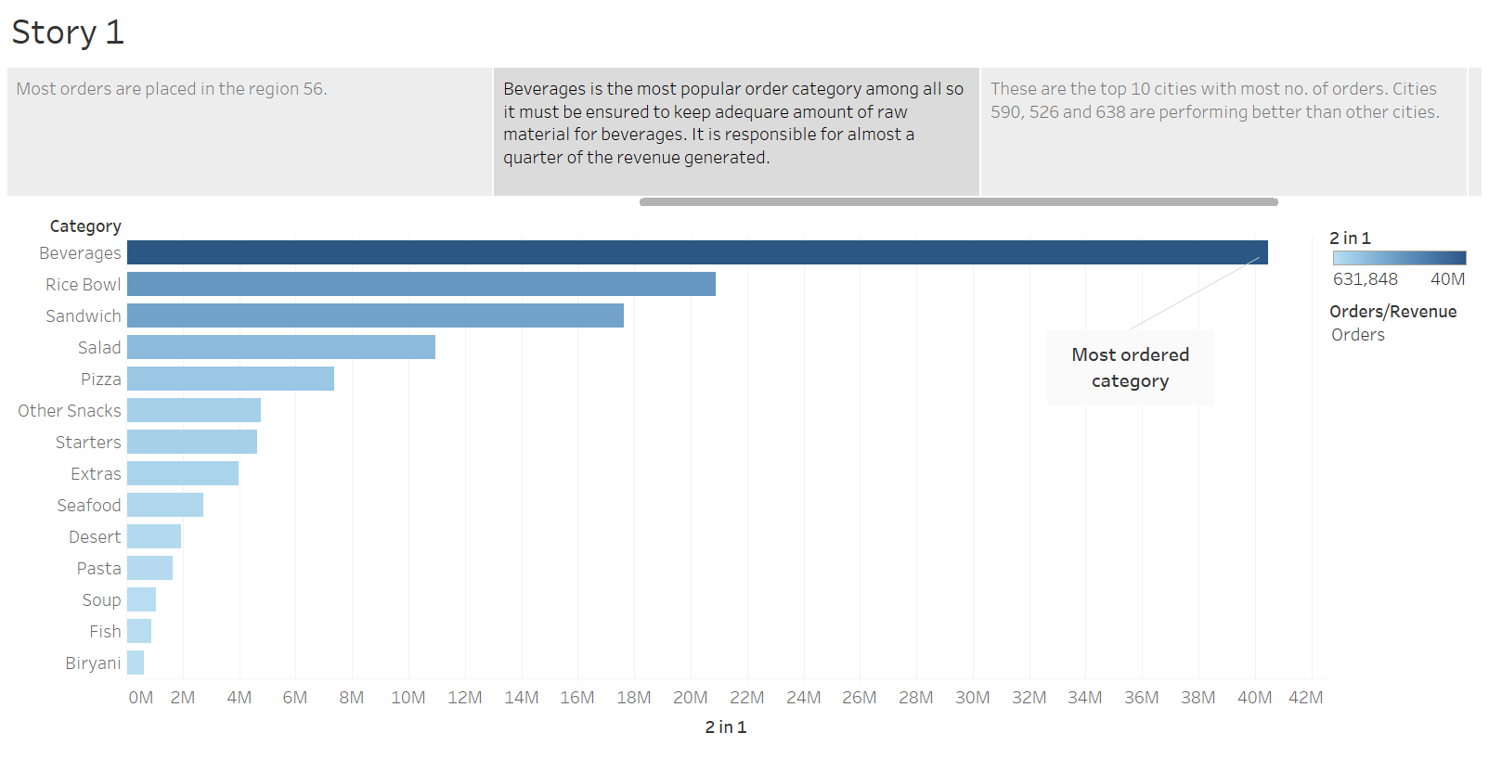

Slide 13
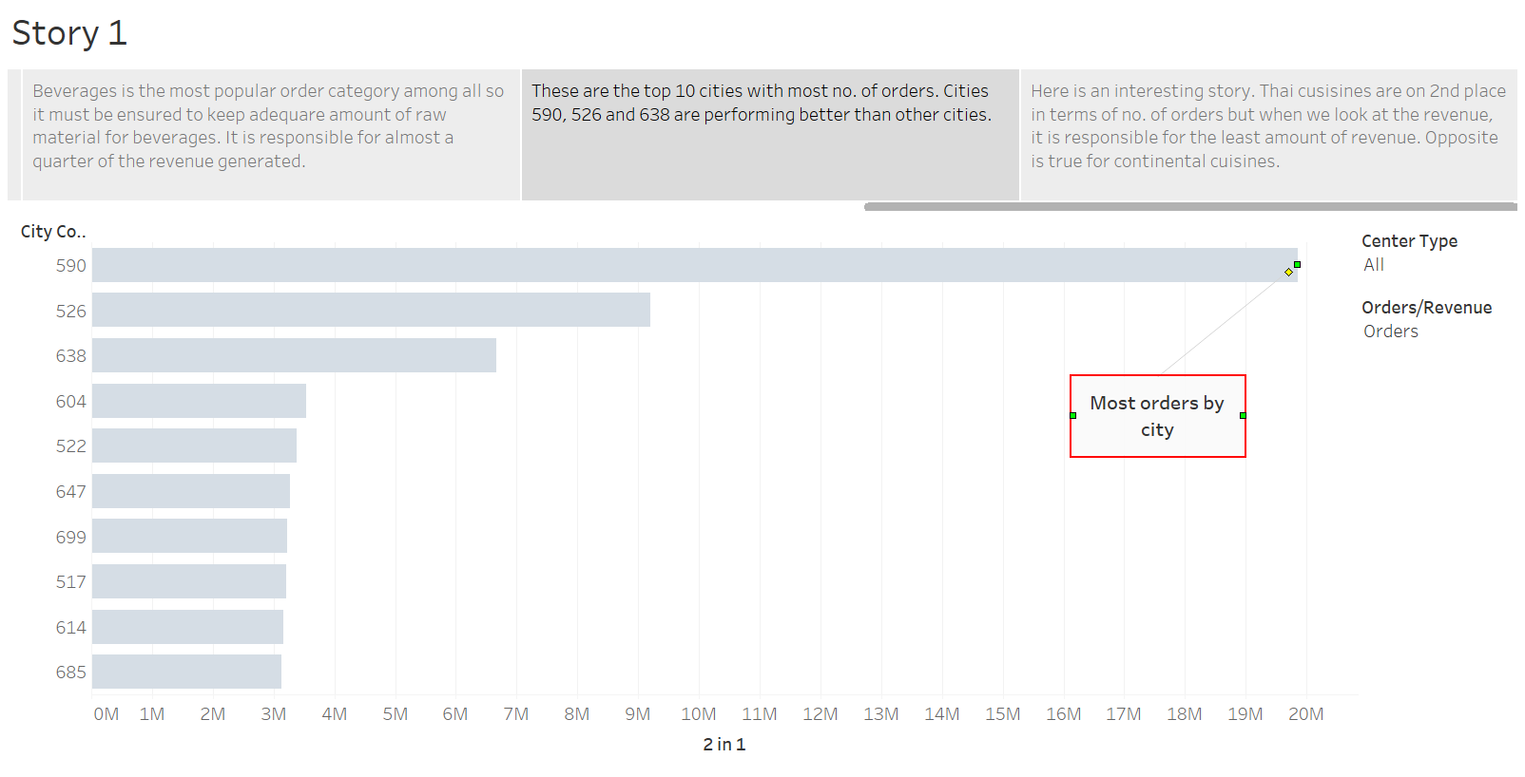

Slide 14
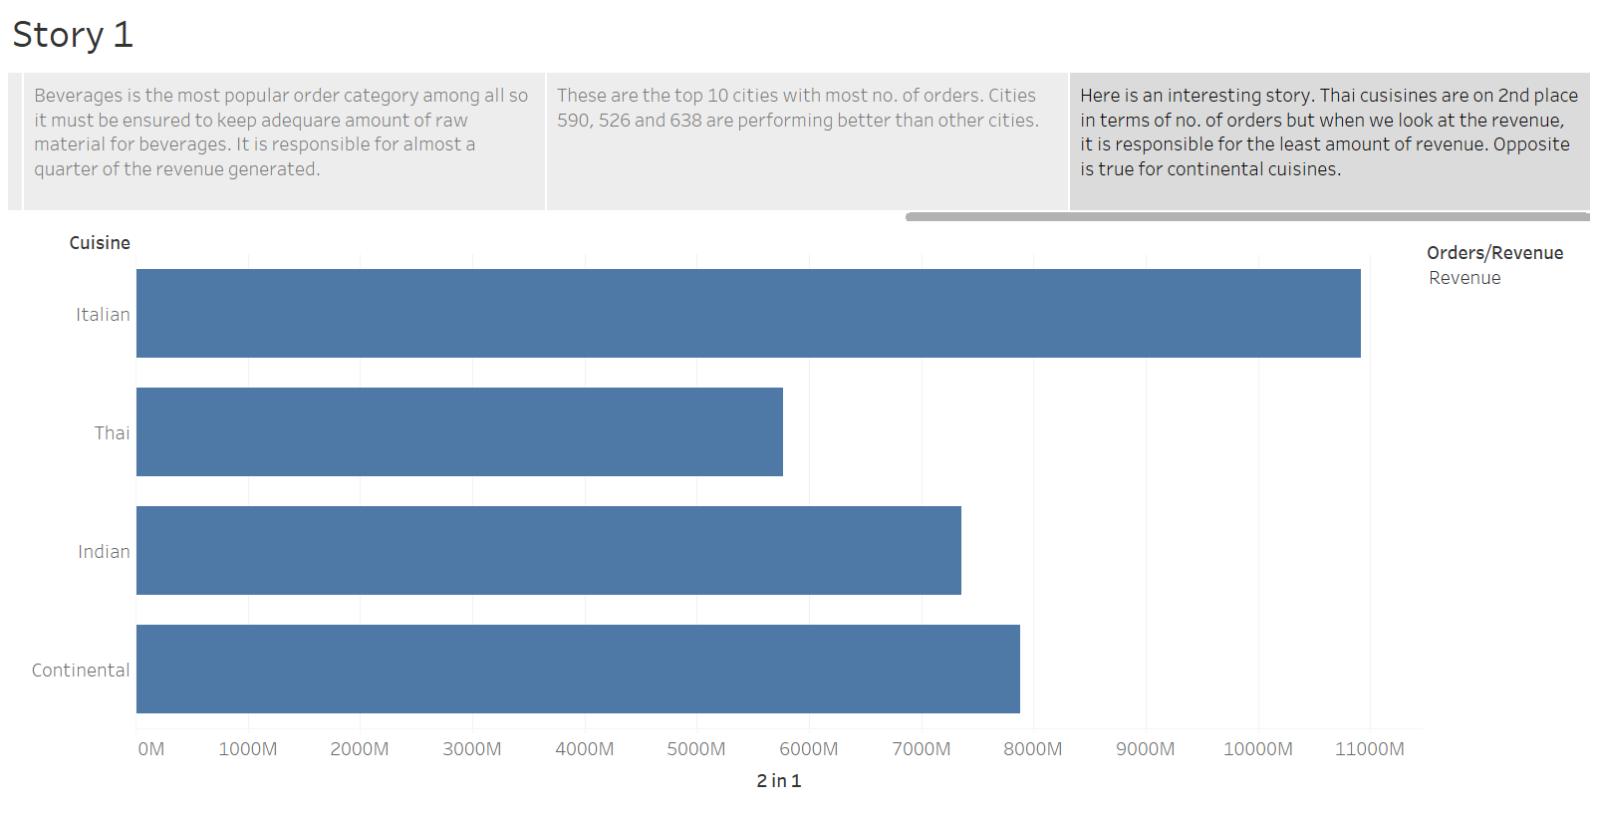

Slide 15
Summary
Beverages is the category for which most no. of orders are made.
Orders of Fish and soup category are seeing a positive trend which means their demand is still in growth stage and adequate raw material stock must me maintained for these categories.
We can increase the no. of type B centers, as they have the highest average no. of weekly orders.
12 of the top 20 centers by no. of orders are from Type A centers and remaining 8 are from the Type B centers. Type C centers are not performing good in terms of no. of orders.
Italian cuisines have a high demand. Continental cuisines have a better revenue with respect to its no. of orders.

